Slide 1
Predicting House Prices in King’s County
Maree Marinelis

Slide 2

Summary
Conducted data analysis on Kings County Housing Market
Created and validated four models to determine key features that make a house more valuable
Further investigation required to create a more holistic analysis

Slide 3
Outline
Business Problem
Data & Methods
Results
Conclusion

Slide 4
Business Problem
Real-Estate Agency understanding the key features and dynamics that drive house values.

Slide 5
Data & Methods
Four models created and improved upon each time
Removed outliers and select variables that that were not conducive to our analysis
Validated our models to ensure accurate predicting power

Slide 6
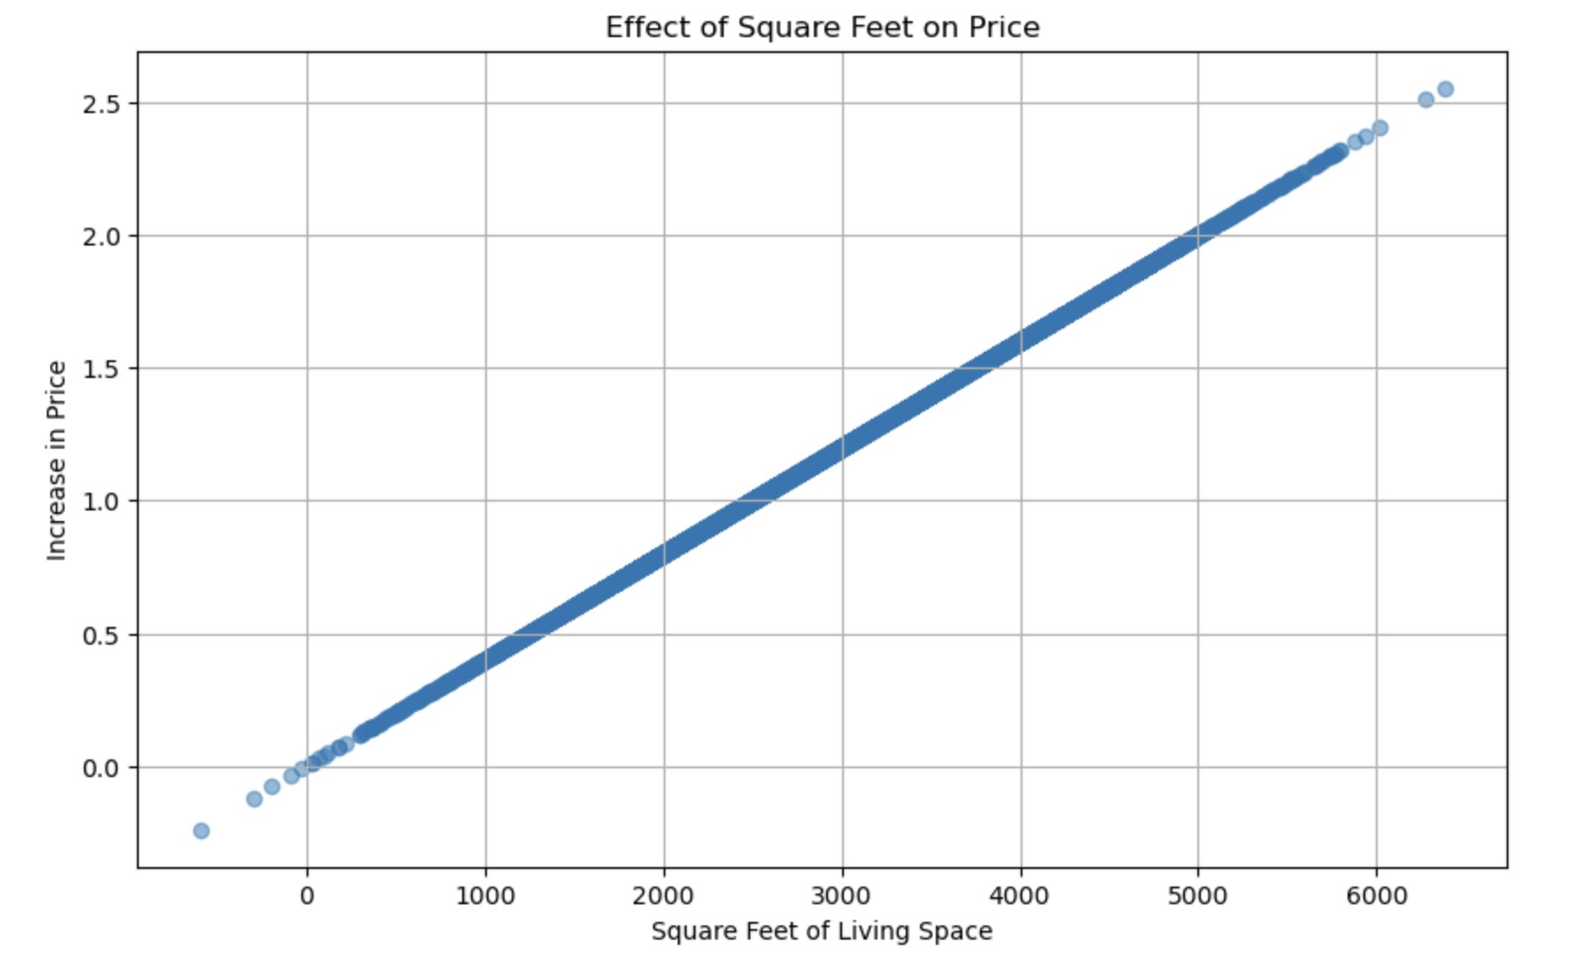
Feature 1
Square-Foot Living
A larger living space positively impacts the house price, with each additional square-foot increasing the price.

Slide 7
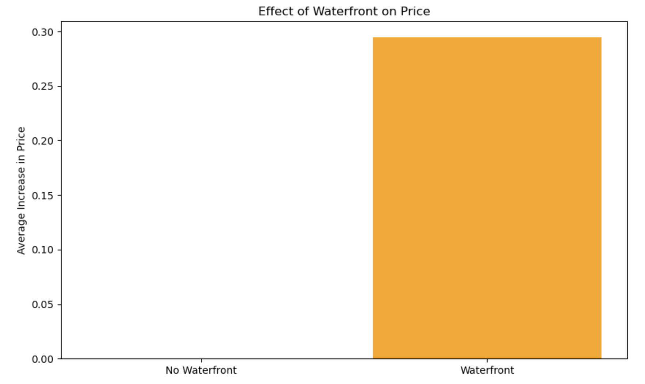
Feature 2
Waterfront
Houses with waterfronts are valued significantly higher than those without.

Slide 8
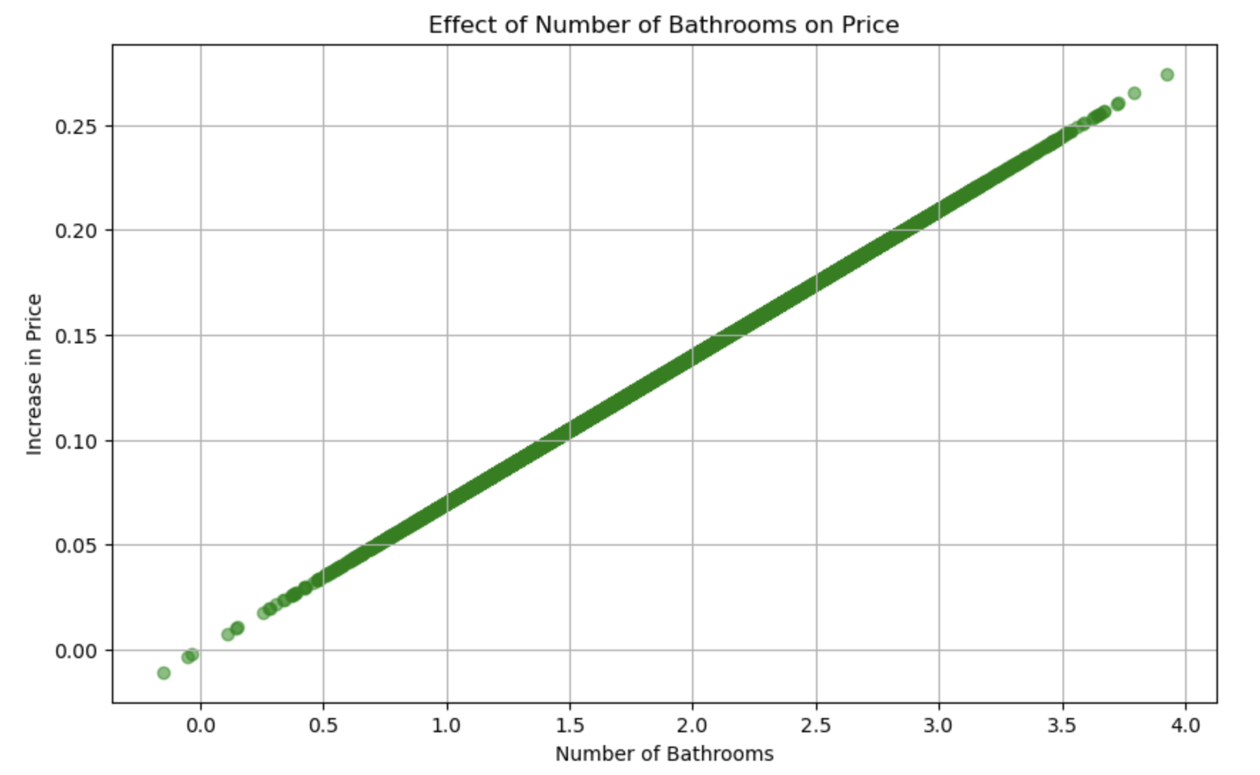
Feature 3
Bathrooms
More bathrooms contribute to an increase in the house price.

Slide 9


Conclusion
Additional Recommendations and insights gathered
Views
Bedrooms
Grade
Review the data, expand our dataset, and investigate limitations further

